Slide 1
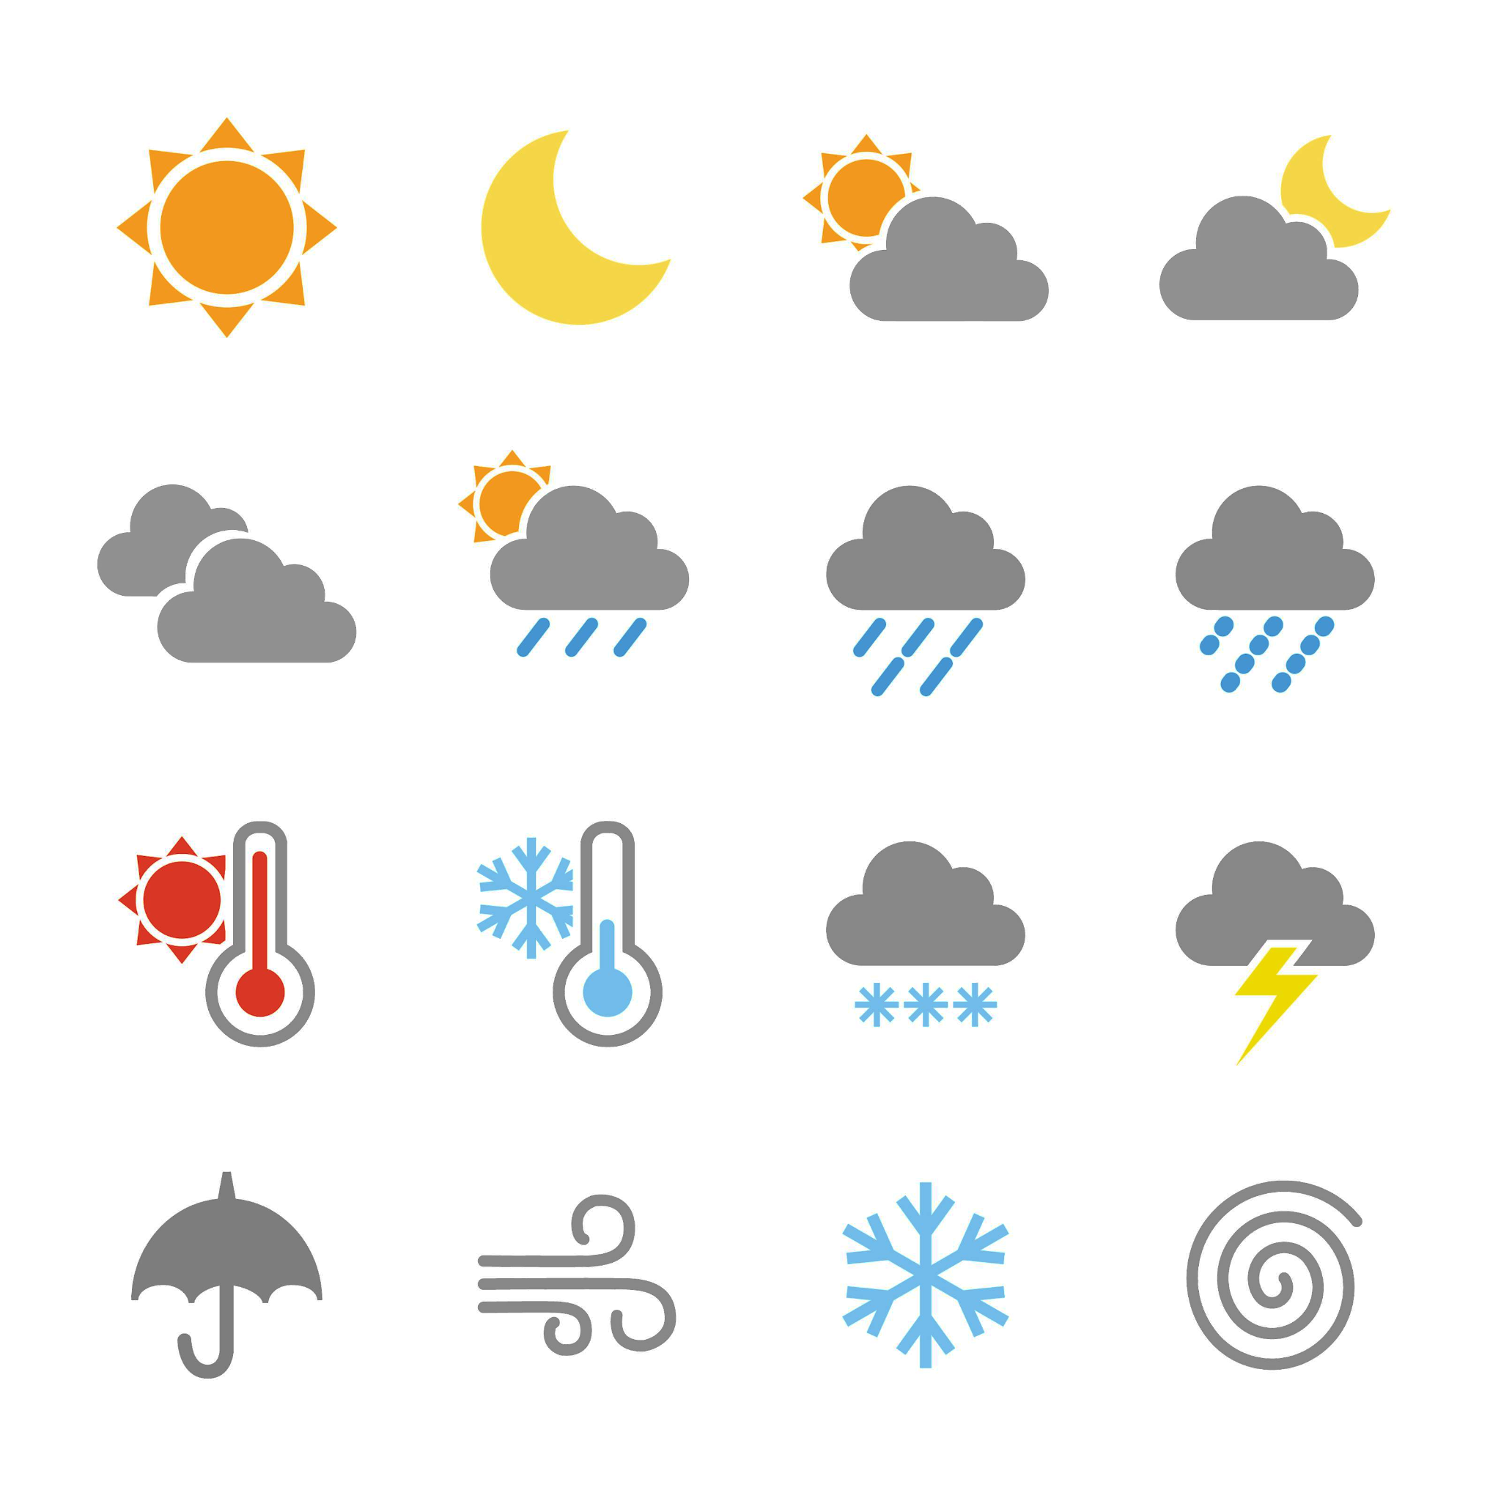
Predicting the weather
Task A: Rainfall forecasting
1) This report was published on Saturday, and shows the forecast for the next week.
 | Mon | Tue | Wed | Thu
Type of rainfall
amount of rainfall (mm)
chance of rainfall | 75% | 40% | 15% | 90%
a) Match the following amounts of rainfall to the days they are most likely to occur.
0.7 mm
1.6 mm
5 mm
8.5 mm
b) Sofia says: “it is guaranteed to rain on Thursday because 90% is a larger number than the other percentages”. Explain why Sofia is incorrect.
c) Suggest one possible reason why Wednesday still has a chance of rain, even though it is only predicted to be cloudy.
Weather images: Raura7/ Shutterstock.com

Slide 2
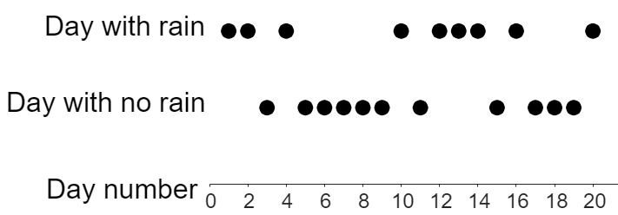
Predicting the weather
2) This report shows the amount of rainfall predicted on Saturday and Sunday.
 | Sat | Sun
Type of rainfall
amount of rainfall | 7.5 | 15°C
chance of rainfall | 100% | 73%
a) On Saturday, how many litres of water is predicted to fall for every square metre of land?
A farmer has a field that is 1800 m² in area.
b) How many litres of rain will fall on this field on Saturday? You can use the ratio table given to help.
area (m²) | rainfall
1
c) The farmer says: “3600 litres of rain will fall on my field on Sunday”.
Explain why this may not be true.
3) This graph shows 20 days where the chance of rainfall was 35%. Each dot represents a day that either rained or didn’t rain.
a) How many of these 20 days would we expect to have rain?
b) Complete this table of information for the first 5 days on the graph.
Number of days | 5
Number of days with rain
% of days with rain
c) What percentage of days for the first 10 days on the graph had rain?
d) Does this graph show: “fewer than”, “equal to”, or “greater than” 35% of days with rain?
Weather images: Raura7/ Shutterstock.com
‹#›

Slide 3
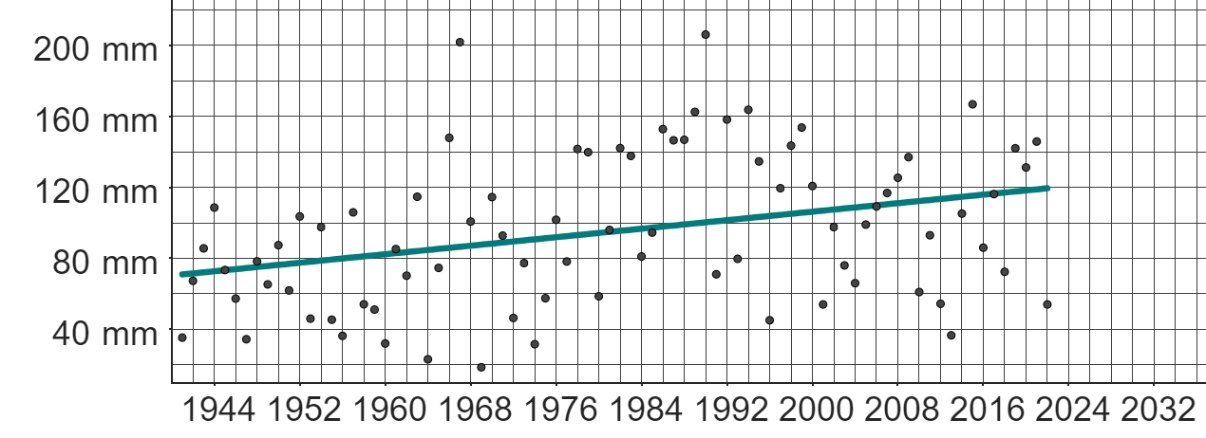
Predicting the weather
Task B: Using historical data to predict the weather
1) This graph shows data from the Met Office on the total monthly rainfall in March each year from 1941 to 2022 in Stornoway.
a) Write a sentence explaining what the trendline is suggesting about the total amount of monthly rainfall each March.
b) Izzy says:
“The amount of rainfall in March 2022 is lower than in March 2021. This means the amount of rainfall in March 2023 will be even lower”.
Explain why Izzy’s assumption may not be correct.
c) Extend the trendline beyond 2022.
d) Using your extended trendline, make a prediction for the total amount of rainfall in March 2024.
e) Explain why your prediction in part d) may not be accurate.
f) Suggest a suitable range of likely predictions by considering a broader trend in the data.
g) If this was the weather forecast for March 2024 in Stornoway (based on weather conditions at the end of February 2024), explain how this might impact your prediction from part c).
week 1 | week 2 | week 3 | week 4 | week 5
12°C | 13°C | 9°C | 11°C | 13°C
Weather images: Raura7/ Shutterstock.com
Mathematics in Education and Industry
v2.4

